Slide 1
Night light project
Design Gallery

Slide 2
Available designs
Unicorn
Donkey (R)
Donkey (L)
Spongebob
Minion
BB–8
X-wing
C–3PO
Sheep
Teddy w. balloons
Teddy dog
Gyroscope
Dolphin
Racing car
Rabbit
Rabbit w. b’flies
Hot air balloons
T-Rex
Torus
Brian
Spiderman
Mickey Mouse
Bambi
Prime mover
Soccer ball
Basketball
Lotus flower
Tulips w. ribbon
Batman sign
Christmas tree

Slide 3
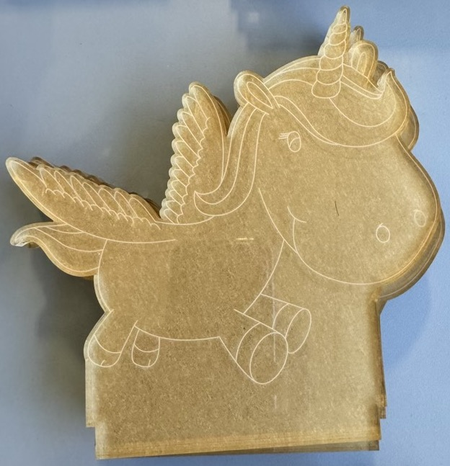
Unicorn flying

Slide 4
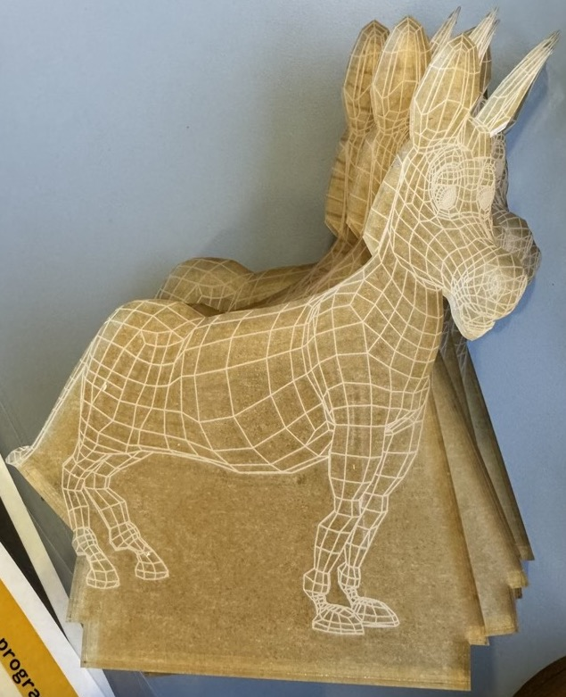
Donkey (right/long)

Slide 5
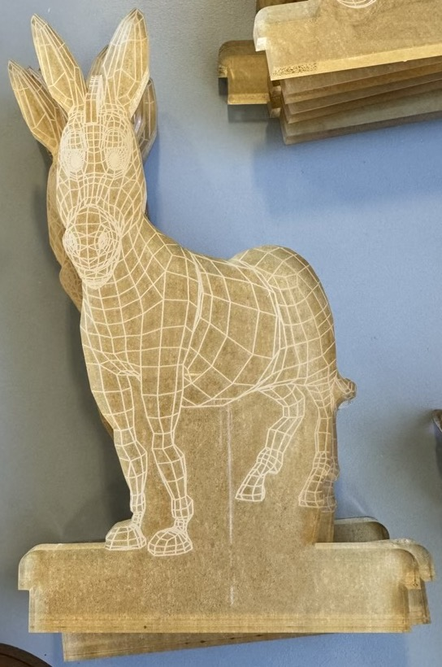
Donkey (left/tall)

Slide 6
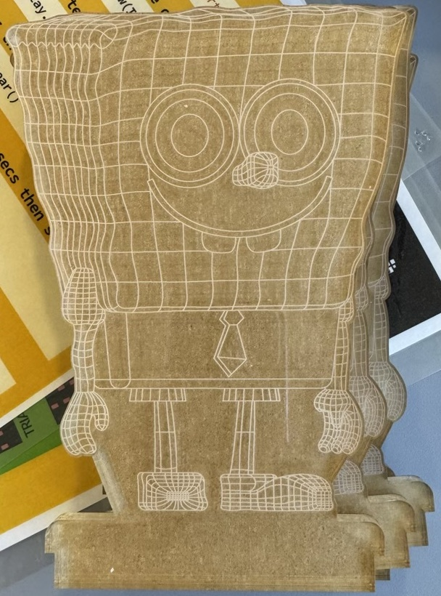
Spongebob Squarepants

Slide 7
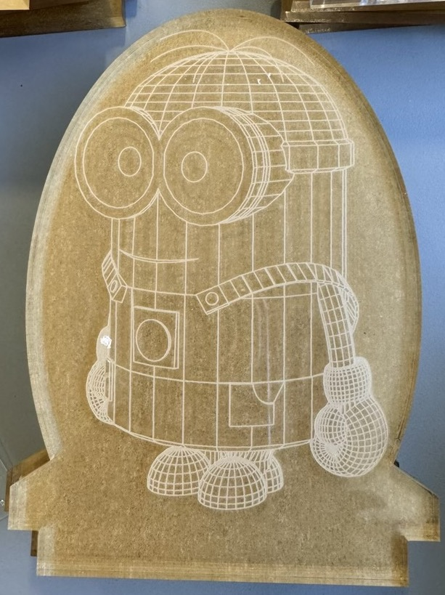
Minion Dave

Slide 8
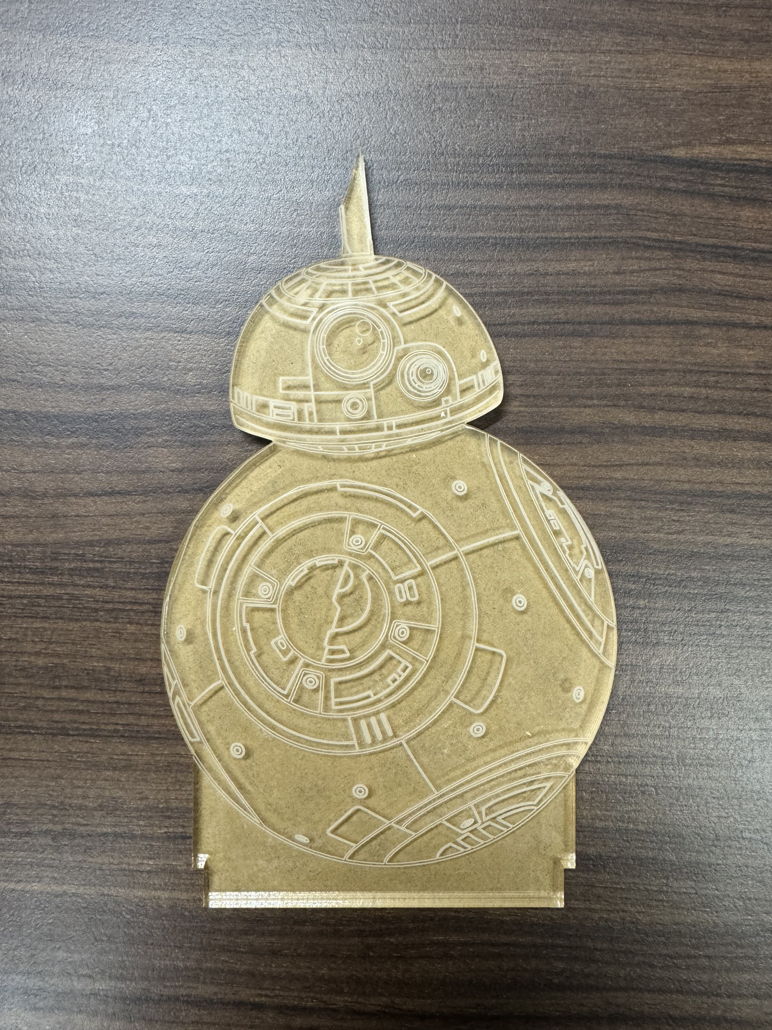
BB-8 (Beebee-Ate)

Slide 9
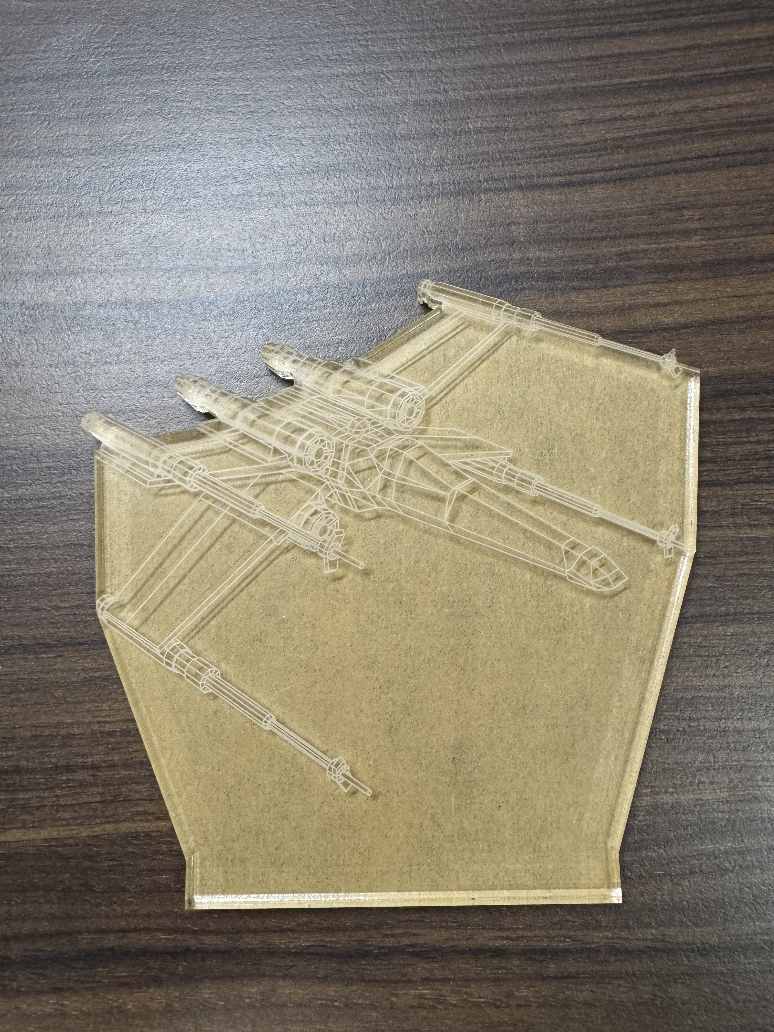
X-wing

Slide 10
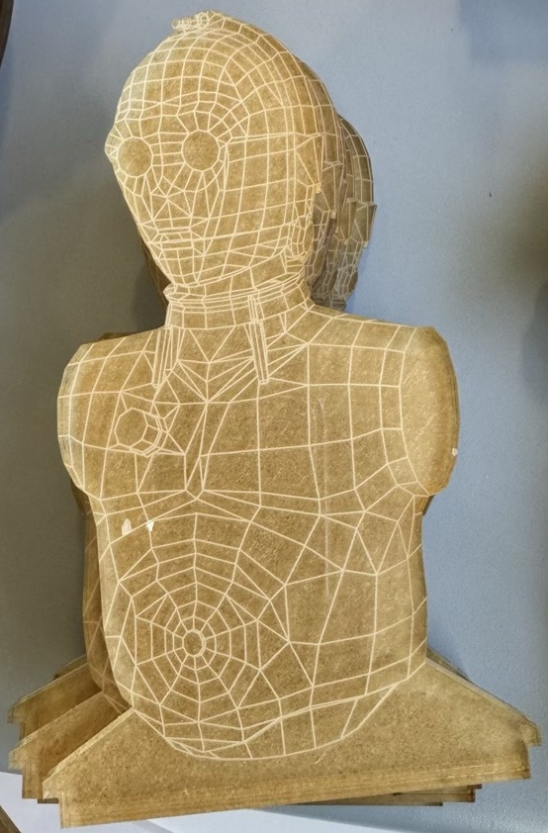
C-3PO (See-Threepio)

Slide 11
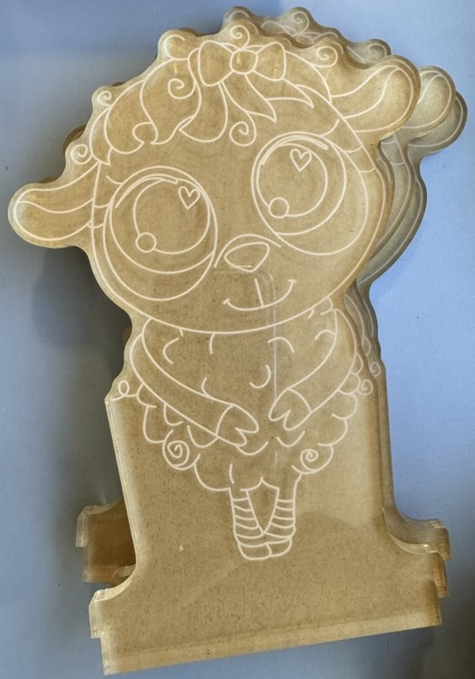
Sheep

Slide 12
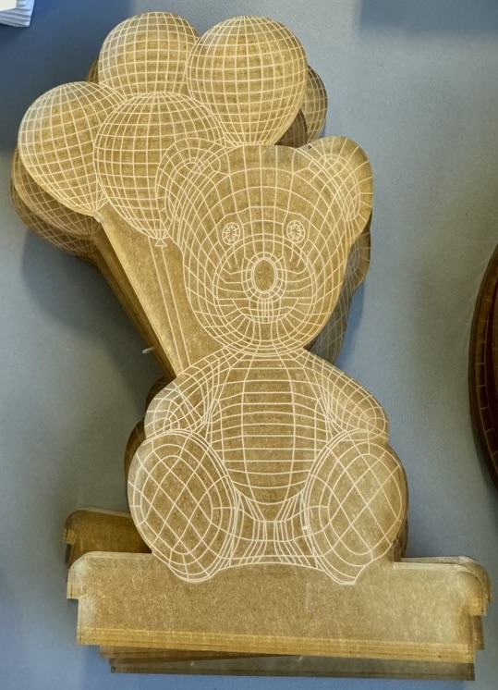
Teddy with balloons

Slide 13
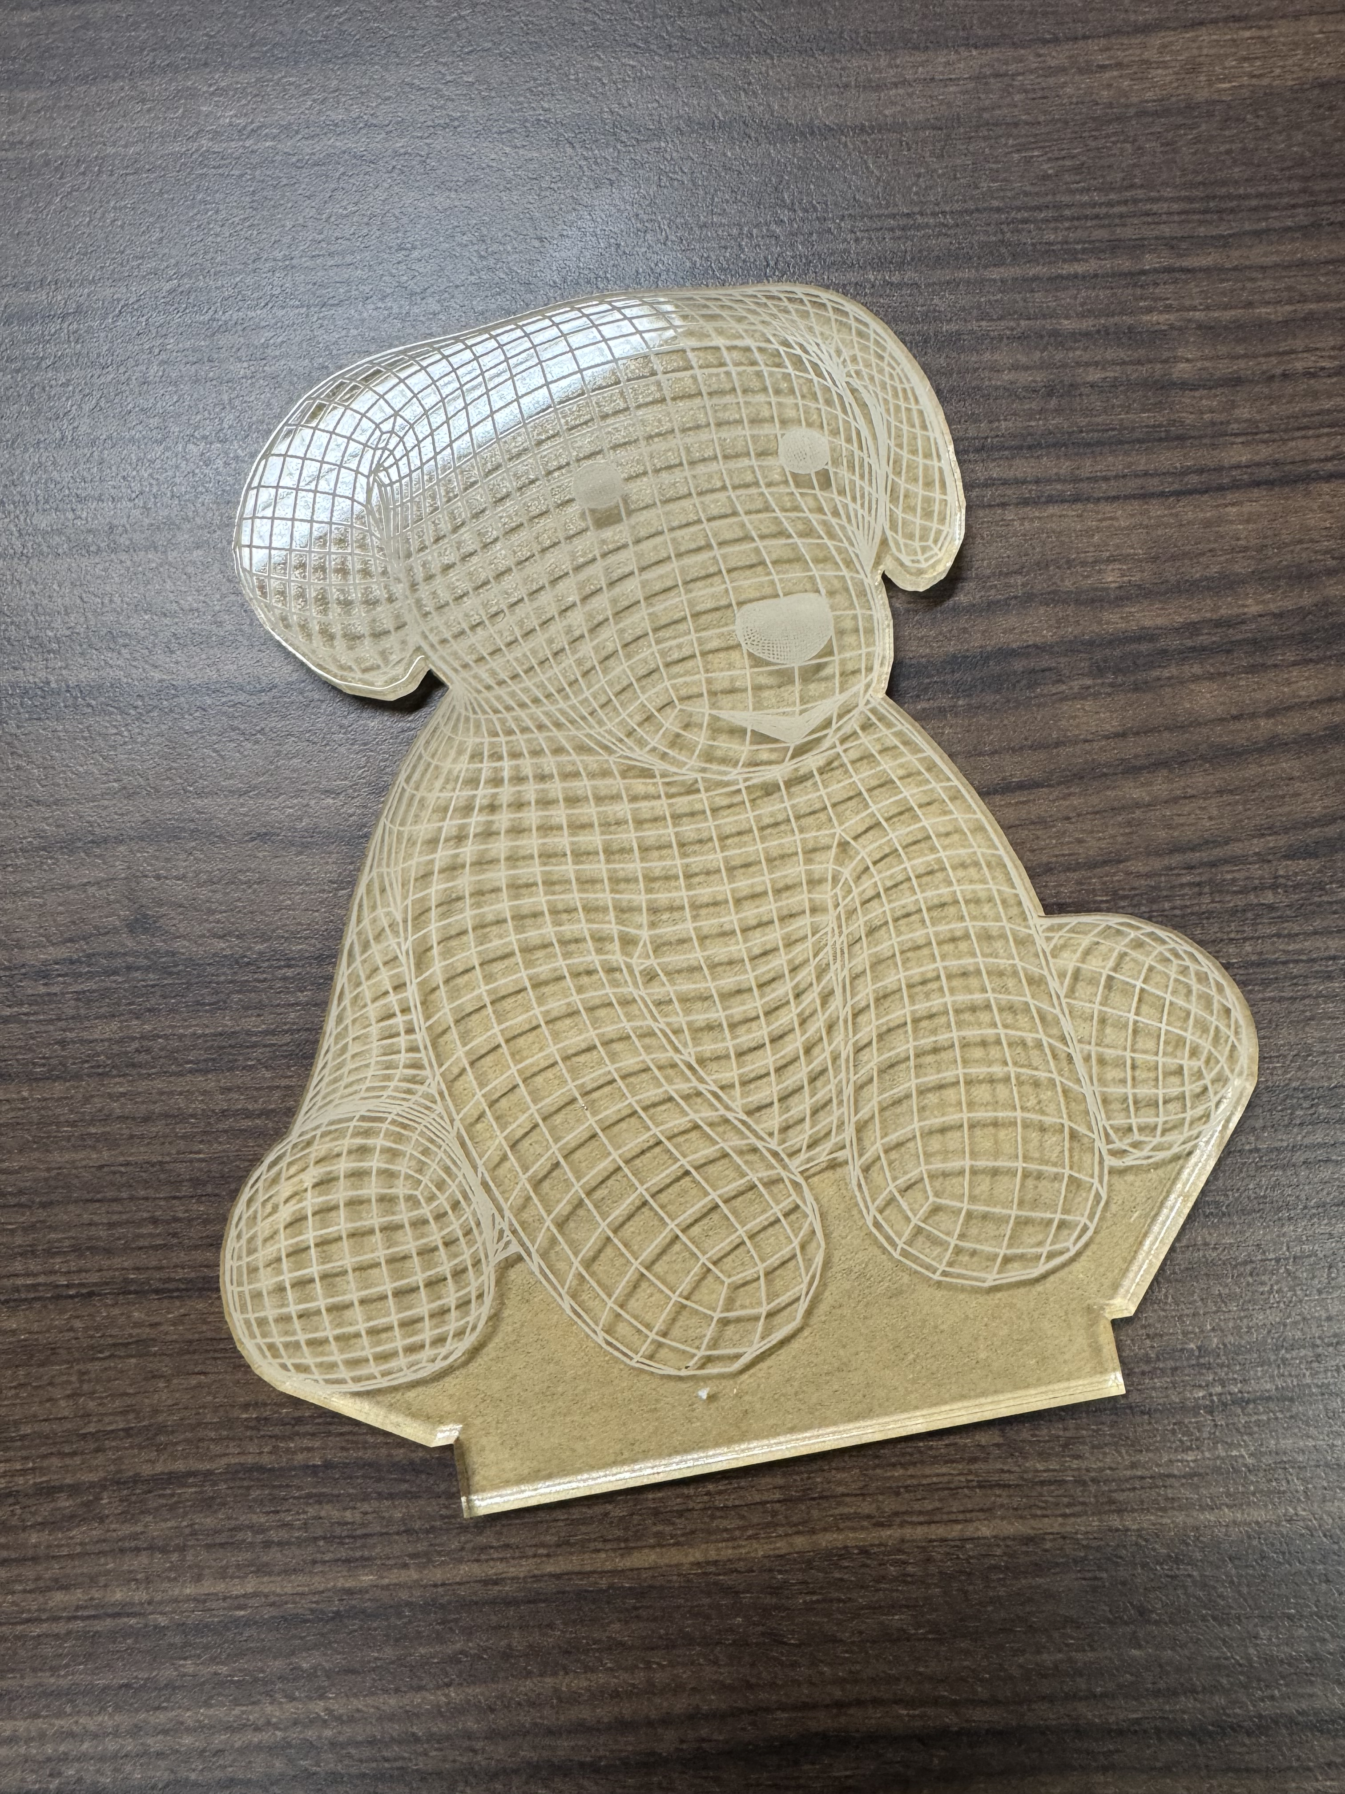
Teddy dog

Slide 14
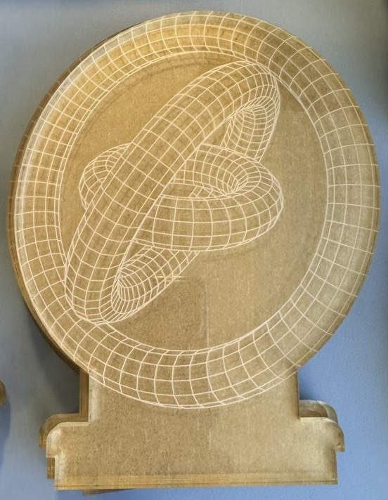
Gyroscope

Slide 15
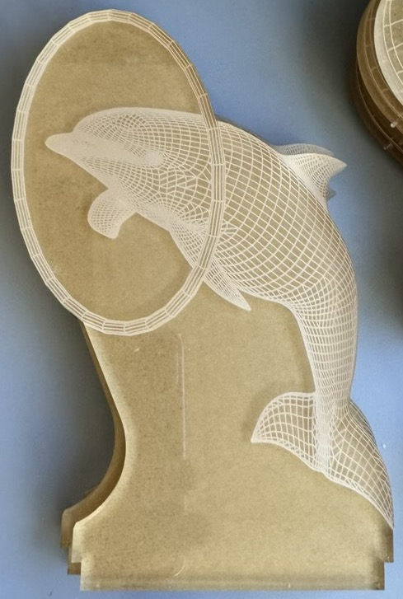
Dolphin performing

Slide 16
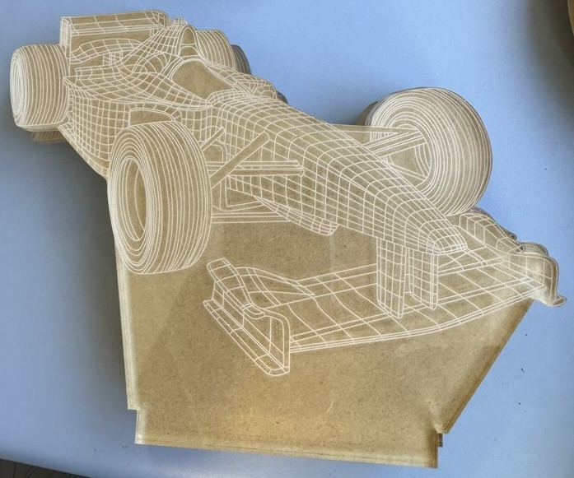
Racing car

Slide 17
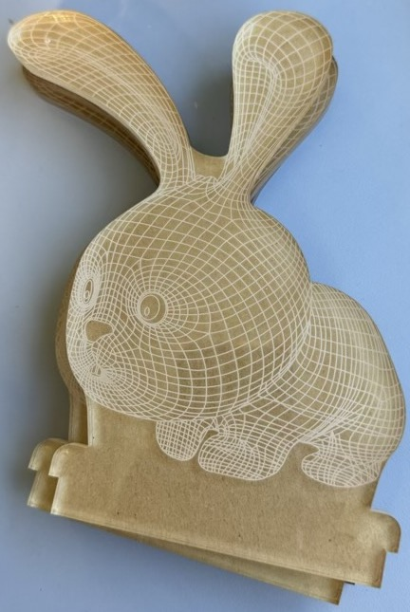
Rabbit

Slide 18
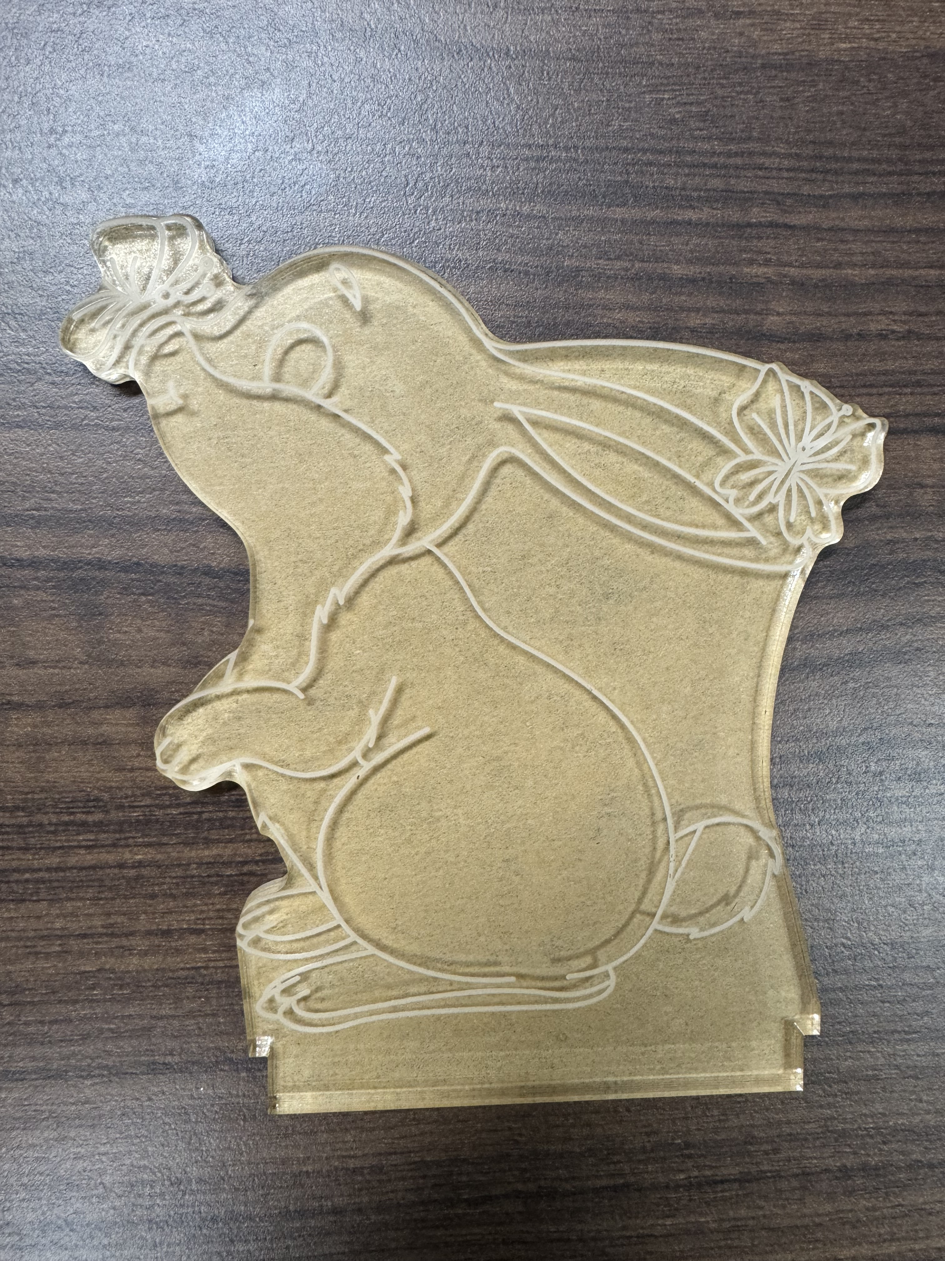
Rabbit with butterflies

Slide 19
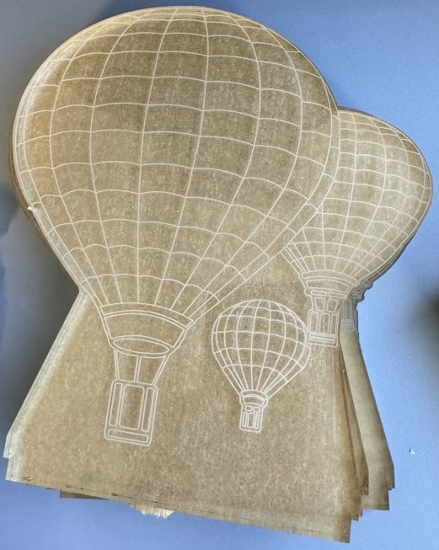
Hot air balloons

Slide 20
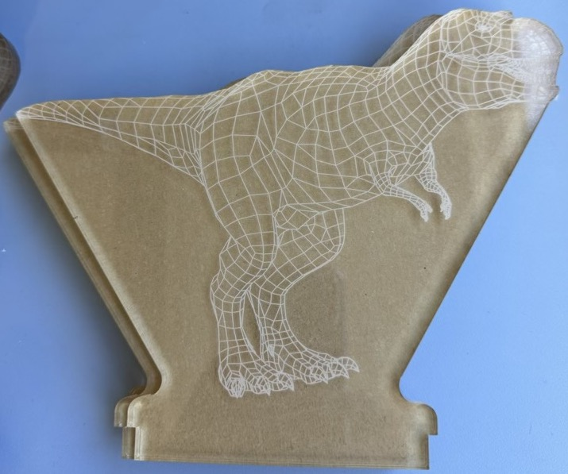
Tyrannosaurus Rex

Slide 21
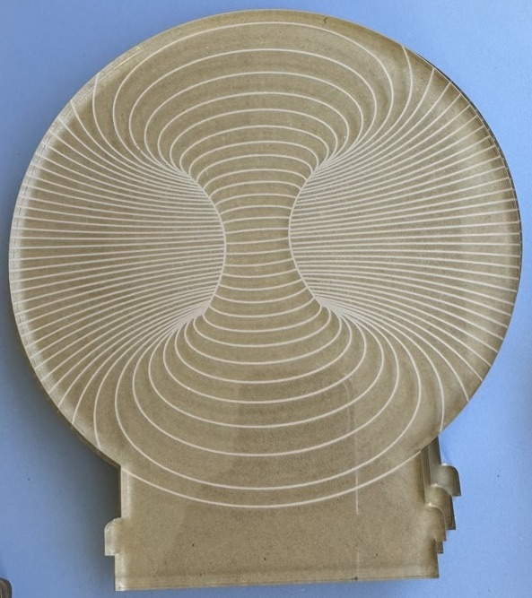
Torus

Slide 22
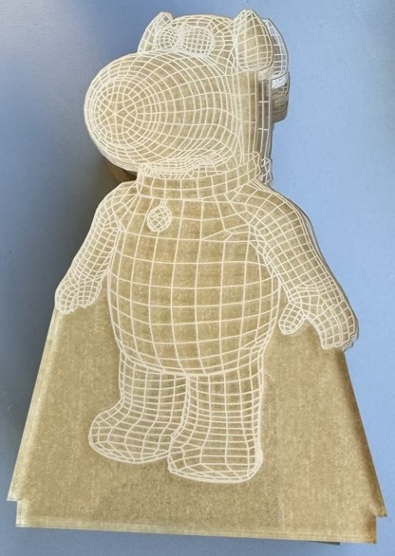
Brian the dog

Slide 23
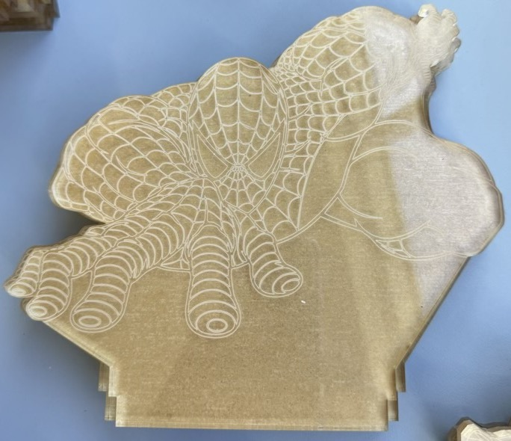
Spiderman

Slide 24
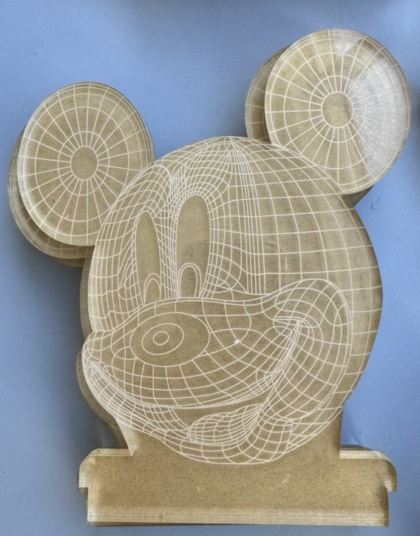
Mickey Mouse

Slide 25
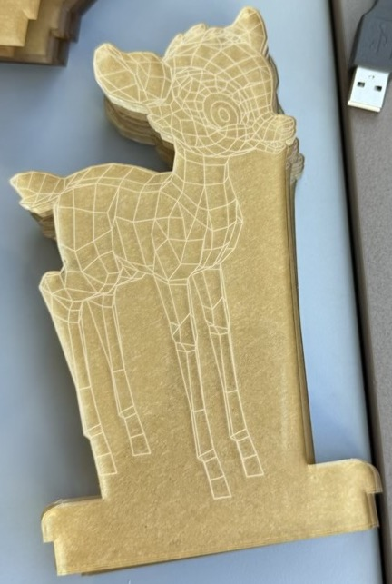
Bambi the fawn

Slide 26
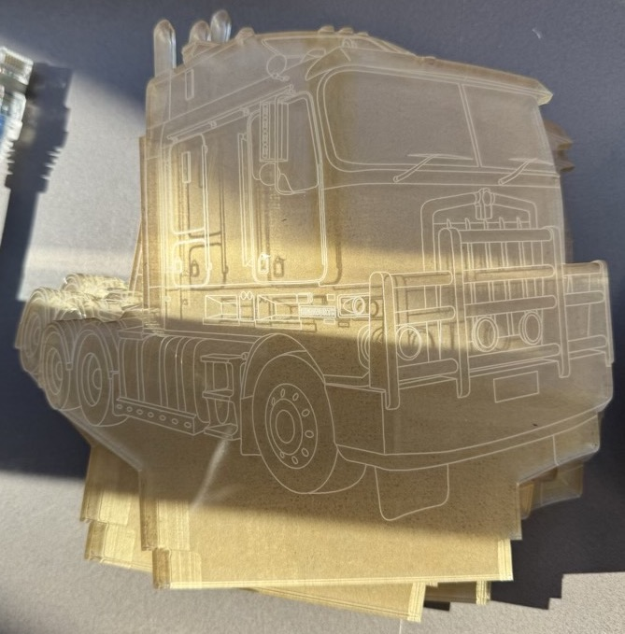
Prime mover

Slide 27
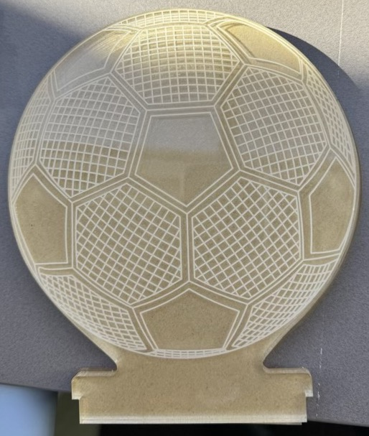
Soccer ball (or football, for the purists)

Slide 28
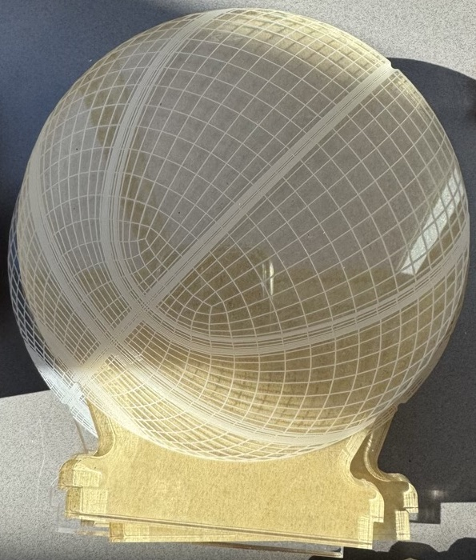
Basketball

Slide 29
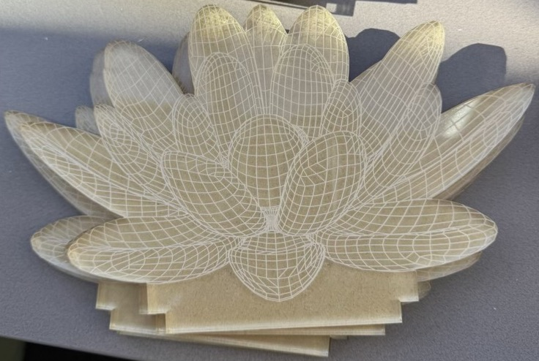
Lotus flower

Slide 30
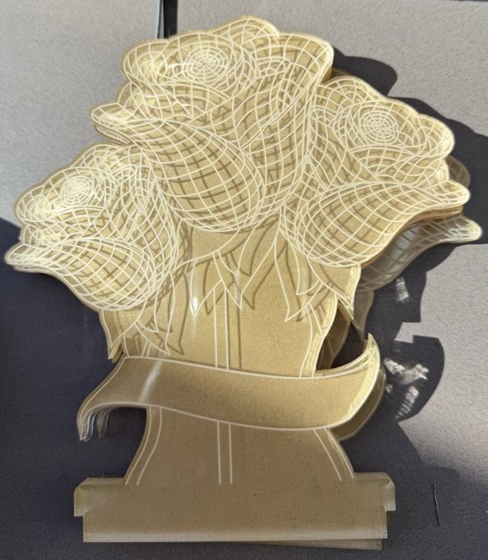
Tulips with ribbon

Slide 31
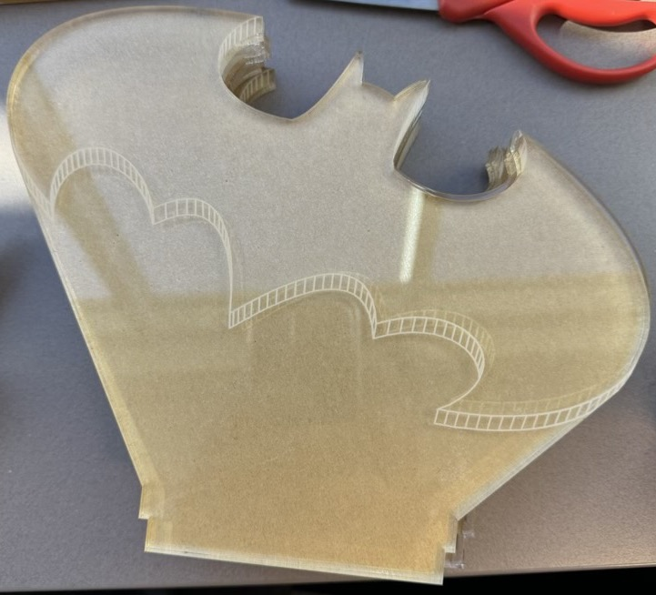
Batman sign

Slide 32
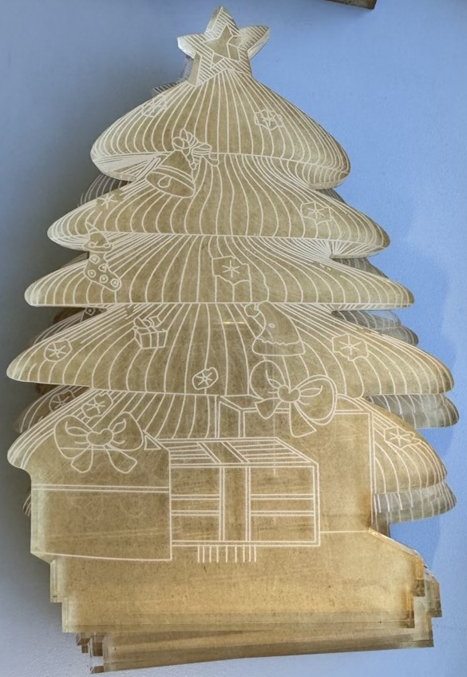
Christmas tree

